Slide 1
Physiological psychology unit-2

Slide 2
Biopsychology
Definition: It is the systematic study of the interaction between biology, behaviour and the environment. Biopsychology is a branch of psychology that analyzes how the brain, neurotransmitters, and other aspects of our biology influence our behaviors, thoughts, and feelings. It can also be known as Biological Psychology, Psychobiology, Physiological Psychology or Behavioural Neuroscience.
AKA
  Biological Psychology / Biopsychology
    Neuropsychology
  Psychobiology
  Physiological Psychology
  Behavioural Neuroscience (Select Branch)

Slide 3
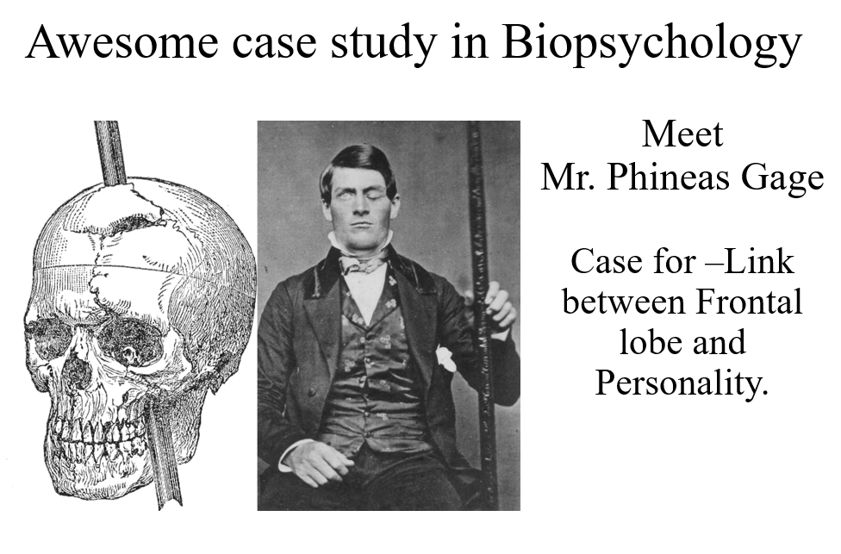
Biopsychology

Slide 4
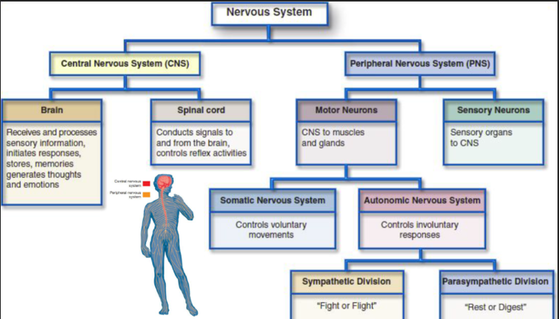
Biopsychology
The Brain & Nervous System

Slide 5
Biopsychology
For vertebrates, we distinguish the central nervous system from the peripheral nervous system. The central nervous system (CNS) is the brain and the spinal cord. The peripheral nervous system consists of the nerves outside the brain and spinal cord. Part of the PNS is the somatic nervous system, which consists of the axons conveying messages from the sense organs to the CNS and from the CNS to the muscles. Another part of the PNS, the autonomic nervous system, controls the heart, the intestines, and other organs. The autonomic nervous system has some of its cell bodies within the brain or spinal cord and some in clusters along the sides of the spinal cord.

Slide 6
Biopsychology
Sympathetic & Parasympathetic NS.
The sympathetic and parasympathetic nervous systems are two branches of the autonomic nervous system, which controls involuntary bodily functions. They work in opposition to maintain homeostasis.
Feature | Sympathetic Nervous System | Parasympathetic Nervous System
Main Function | The sympathetic nervous system prepares the body for stressful or emergency situations. | The parasympathetic nervous system helps the body relax and recover after stress or activity.
Heart Rate | It increases the heart rate to supply more oxygen to muscles. | It decreases the heart rate to conserve energy.
Respiration | It increases the breathing rate and dilates the airways to enhance oxygen intake. | It slows down the breathing rate and constricts the airways to maintain normal respiration.
Pupil Size | It dilates the pupils to improve vision in low-light or danger situations. | It constricts the pupils to support normal vision in safe and restful conditions.
Digestive Activity | It slows down or inhibits digestion to prioritize energy for immediate action. | It stimulates digestion to promote rest, recovery, and energy storage.
Saliva Production | It reduces saliva production, as digestion is not a priority during stress. | It increases saliva production to aid in digestion.
Bladder Function | It relaxes the bladder, temporarily inhibiting urination during stress. | It contracts the bladder and promotes normal urination.
Energy Use | It mobilizes energy by increasing glucose release into the bloodstream. | It conserves energy by encouraging the storage and slow release of glucose.
Neurotransmitter Used | It primarily uses norepinephrine as its neurotransmitter. | It primarily uses acetylcholine as its neurotransmitter.

Slide 7
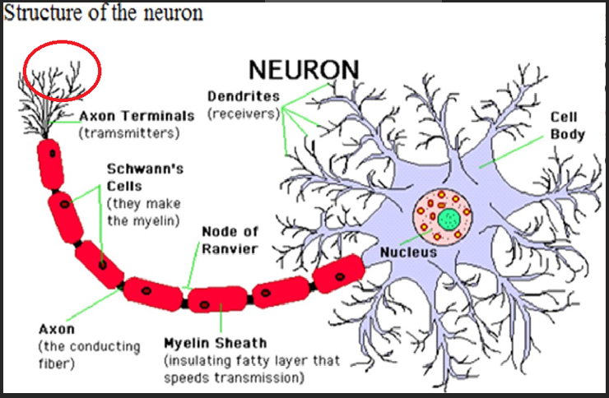
Structure of the Neuron

Slide 8
Structure of the Neuron
In addition to having all the normal components of a cell (nucleus, organelles, etc.) neurons also contain unique structures for receiving and sending the electrical signals that make neuronal communication possible.
Dendrite: Dendrites are branch-like structures extending away from the cell body, and their job is to receive messages from other neurons and allow those messages to travel to the cell body. Although some neurons do not have any dendrites, other types of neurons have multiple dendrites. Dendrites can have small protrusions called dendritic spines, which further increase surface area for possible connections with other neurons.
Cell Body :Like other cells, each neuron has a cell body (or soma) that contains a nucleus, smooth and rough endoplasmic reticulum, Golgi apparatus, mitochondria, and other cellular components.
Axon : An axon, at its most basic, is a tube-like structure that carries an electrical impulse from the cell body (or from another cell’s dendrites) to the structures at opposite end of the neuron—axon terminals, which can then pass the impulse to another neuron. The cell body contains a specialized structure, the axon hillock, which serves as a junction between the cell body and the axon.

Slide 9
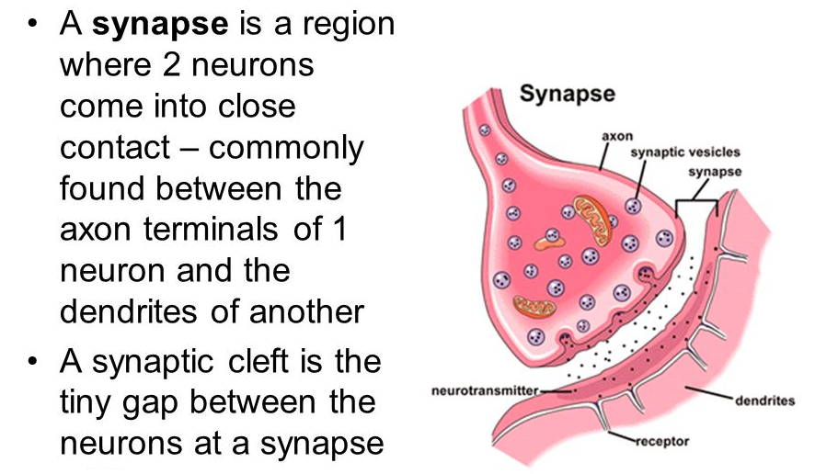
Structure of the Neuron
Synapse: The synapse is the chemical junction between the axon terminals of one neuron and the dendrites of the next. It is a gap where specialized chemical interactions can occur, rather than an actual structure.

Slide 10
NEUROTRANSMITTERS
Neurotransmitters are endogenous chemical messengers that transmit signals from a neuron to a target cell across a synapse.
Neurotransmitters are chemical messengers that transmit signals across synapses from one neuron to another. They play a key role in regulating mood, behavior, cognition, and bodily functions.
Types of Neurotransmitters:
Excitatory Neurotransmitters – Increase the likelihood of the receiving neuron firing.
Example: Glutamate – involved in learning and memory.
Inhibitory Neurotransmitters – Decrease the likelihood of the receiving neuron firing.
Example: GABA (Gamma-Aminobutyric Acid) – calms neural activity, reduces anxiety.
Modulatory Neurotransmitters – Influence large numbers of neurons and modulate other neurotransmitters.
Example: Dopamine, Serotonin – affect mood, motivation, and arousal.

Slide 11
Sensation :
Sensation
Everything we experience comes to us by means of our sense organs. These may be thought of as receiving stations for stimuli which come from outside and from within our body. It is the process that occurs when special receptors in the sense organs are activated, allowing various forms of outside stimuli to become neural signals in the brain.
Sensation is the process by which our sensory receptors and nervous system receive and transmit information from the environment to the brain.
What is stimulus?
A stimulus is any kind of mechanical, physical, or chemical change that acts upon a sense organ. The important feature is the element of 'change'.

Slide 12
Perception :
Perception is the organisation, identification and interpretation of sensory information in order to represent and understand the presented information. Sensation occurs when energy in the external environment or the body stimulates receptors in the sense organs. All perception involves signals that go through the nervous system, which in turn results from physical or chemical stimulation of the sensory system. Perception is not only the passive receipt of these signals, but it is also shaped by the recipient’s learning, memory, expectation, attention and emotion.

Slide 13
Sensation vs Perception :
Sensation | Perception
The process of receiving information through your senses, which can be interpreted by your brain. | The process of interpreting the information received by the sensation process.
The source is the stimuli received by your senses | The source is the information sent to the brain through sensation
Sensation results in raw information from your senses | Perception results in meaning of that information
Sensation is a general biological process | Perception is a more psychological process because information that is already stored within your brain affects the outcome

Slide 14
Attention :
Attention
“Attention can be defined as a process which compels the individual to select some particular stimulus according to his interest and attitude out of the multiplicity of the stimuli present in the environment” – Sharma R.N (1967).
Attention is the ability to actively process specific information in the environment while tuning out other details. Attention is limited in terms of both capacity and duration.
Determinants of Attention:
There are a number of factors that determine if and how much attention a stimulus is capable of attracting and maintaining.
The factors that influence attention of an individual may be classified into External and Internal Factors.

Slide 15
Attention :
Objective / External factors:
Intensity of the stimulus: It is the most important factor. When it persists for a prolong time it may be neglected. in contrast the sudden decrease in intensity may get attention. Example: A loud sound or a bright light that demands an attention.
Novelty: New objects create awareness easily and it creates an interest and curiosity. Example: when a new student enters a classroom where other old students are there. So, the new student is a stimulus there which captures everyone’s attention.
Extensity or size: A bigger object captures attention better than a smaller one. Example: a full-page advertisement in the newspaper, advertisement in a small space may go unnoticed
Change: Change in the stimulus is likely to attract attention. Example: change in voice of a person during a speech
Movement: Objects in motion attracts our attention. Example: when we are waiting in a railway platform and as soon as the train comes, we will pay attention to it
Contrast: A contrasting stimulus will capture our attention soon. according to Guilford, “contrast in color or sound produces immediate awareness and leads to concentration and
attention”. Example: the presence single boy in a group of girls.
Repetition: If a stimulus is repeated, it is more likely to attract our attention than a non- repeated one. Example: waiting for the same bus stand where the bus stood there for several times

Slide 16
Attention :
Internal stimulus:
Interest: It is a most important factor. Where we pay more attention and concentrate on a thing which is more interesting one.
Instinct: Instincts are the “primary - movers” of our behavior. so, the things which suits or appeals to our instinct will attract attention
Emotions and sentiments: These are said to be “internal motivations” of attention.
Habits: Habits is a great incentive in attention. In the case of some people, it is difficult to get rid of a particular habit and they must attend to such a task throughout the day whatever be the seriousness of other task. Example: alcoholism
Temperament: People of different temperament attend to different objects. Example: An extrovert will attend different things while an introvert will not even notice their existence
Physiological condition: fatigue and illness destroy attention and interest

Slide 17
TYPES OF ATTENTION
Sustained Attention
Sustained attention means focusing on a person, task or activity for a certain time or until the relevant conversation, task or activity is complete. For example, we learn to hone this type of attention at school by engaging with fellow learners and teachers. Another example is when we learn through studying and writing tests and exams.
Selective Attention
Selective attention involves being able to focus on a specific task while simultaneously being able to block out any background noise or stimuli. One example includes being able to read a book while there is loud background noise around you.
Alternating Attention
This is the ability to shift focus back and forth between different tasks or mental demands. It requires mental flexibility. Example: Switching between solving a math problem and answering a phone call.
Divided Attention
This is the ability to respond to multiple tasks or stimuli at the same time. It involves multitasking and processing information from several sources simultaneously. Example: Talking on the phone while cooking.

